Slide 1
Topic :Counting

Slide 2
Introduction
Suppose that a password on a computer system consists of six, seven, or eight characters. Each of these characters must be a digit or a letter of the alphabet. Each password must contain at least one digit. How many such passwords are there? The techniques needed to answer this question and a wide variety of other counting problems will be introduced in this section.
The Product Rule
Suppose that a procedure can be broken down into a sequence of two tasks. If there are n1 ways to do the first task and for each of these ways of doing the first task, there are n2 ways to do the second task, then there are n1n2 ways to do the procedure.

Slide 3
Example
A new company with just two employees, Sanchez and Patel, rents a floor of a building with 12 offices. How many ways are there to assign different offices to these two employees?
Solution
The procedure of assigning offices to these two employees consists of assigning an office to Sanchez, which can be done in 12 ways, then assigning an office to Patel different from the office assigned to Sanchez, which can be done in 11 ways. By the product rule, there are 12 · 11 = 132 ways to assign offices to these two employees.

Slide 4
Example
The chairs of an auditorium are to be labeled with an uppercase English letter followed by a positive integer not exceeding 100. What is the largest number of chairs that can be labeled differently?
Solution
The procedure of labeling a chair consists of two tasks, namely, assigning to the seat one of the 26 uppercase English letters, and then assigning to it one of the 100 possible integers. The product rule shows that there are 26 · 100 = 2600 different ways that a chair can be labeled. Therefore, the largest number of chairs that can be labeled differently is 2600.

Slide 5
Example
There are 32 microcomputers in a computer center. Each microcomputer has 24 ports. How many different ports to a microcomputer in the center are there?
Solution
The procedure of choosing a port consists of two tasks, first picking a microcomputer and then picking a port on this microcomputer. Because there are 32 ways to choose the microcomputer and 24 ways to choose the port no matter which microcomputer has been selected, the product rule shows that there are 32 · 24 = 768 ports.

Slide 6

Extended version of product rule
An extended version of the product rule is often useful. Suppose that a procedure is carried out by performing the tasks T₁, T₂, . . . , T_{m} in sequence. If each task T_{i} , i = 1, 2, . . . , n, can be done in n_{i} ways, regardless of how the previous tasks were done, then there are n₁ · n₂ · · · · · n_{m} ways to carry out the procedure.
Example
How many different license plates can be made if each plate contains a sequence of three uppercase English letters followed by three digits (and no sequences of letters are prohibited)?
Solution
There are 26 choices for each of the three uppercase English letters and ten choices for each of the three digits. Hence, by the product rule there are a total of 26 · 26 · 26 · 10 · 10 · 10 = 17,576,000 possible license plates.

Slide 7
Example (The Telephone Numbering Plan)
The North American numbering plan (NANP) specifies the format of telephone numbers in the U.S., Canada, and many other parts of North America. A telephone number in this plan consists of 10 digits, which are split into a three-digit area code, a three-digit office code, and a four-digit station code. Because of signaling considerations, there are certain restrictions on some of these digits. To specify the allowable format, let X denote a digit that can take any of the values 0 through 9, let N denote a digit that can take any of the values 2 through 9, and let Y denote a digit that must be a 0 or a 1. In the old plan, the formats of the area code, office code, and station code are NYX, NNX, and XXXX, respectively, so that telephone numbers had the form NYX-NNX-XXXX. In the new plan, the formats of these codes are NXX, NXX, and XXXX, respectively, so that telephone numbers have the form NXX-NXX-XXXX. How many different North American telephone numbers are possible under the old plan and under the new plan?

Slide 8
Solution
By the product rule, there are 8 · 2 · 10 = 160 area codes with format NYX and 8 · 10 · 10 = 800 area codes with format NXX. Similarly, by the product rule, there are 8 · 8 · 10 = 640 office codes with format NNX. The product rule also shows that there are 10 · 10 · 10 · 10 = 10,000 station codes with format XXXX.
Consequently, applying the product rule again, it follows that under the old plan there are 160 · 640 · 10,000 = 1,024,000,000 different numbers available in North America.
Under the new plan, there are 800 · 800 · 10,000 = 6,400,000,000 different numbers available.

Slide 9
The Sum Rule
If a task can be done either in one of n₁ ways or in one of n₂ ways, where none of the set of n₁ ways is the same as any of the set of n₂ ways, then there are n₁ + n₂ ways to do the task.
We can extend the sum rule to more than two tasks. Suppose that a task can be done in one of n₁ ways, in one of n₂ ways, . . . , or in one of n_{m} ways, where none of the set of n_{i} ways of doing the task is the same as any of the set of n_{j} ways, for all pairs i and j with 1 ≤ i < j ≤ m. Then the number of ways to do the task is n₁ + n₂ +· · ·+n_{m}.

Slide 10
Example
Suppose that either a member of the mathematics faculty or a student who is a mathematics major is chosen as a representative to a university committee. How many different choices are there for this representative if there are 37 members of the mathematics faculty and 83 mathematics majors and no one is both a faculty member and a student?
Solution
There are 37 ways to choose a member of the mathematics faculty and there are 83 ways to choose a student who is a mathematics major. Choosing a member of the mathematics faculty is never the same as choosing a student who is a mathematics major because no one is both a faculty member and a student. By the sum rule it follows that there are 37 + 83 = 120 possible ways to pick this representative.

Slide 11
Example
A student can choose a computer project from one of three lists. The three lists contain 23, 15, and 19 possible projects, respectively. No project is on more than one list. How many possible projects are there to choose from?
Solution
The student can choose a project by selecting a project from the first list, the second list, or the third list. Because no project is on more than one list, by the sum rule there are 23 + 15 + 19 = 57 ways to choose a project.
Many counting problems cannot be solved using just the sum rule or just the product rule. However, many complicated counting problems can be solved using both of these rules in combination.

Slide 12
Example
In a version of the computer language BASIC, the name of a variable is a string of one or two alphanumeric characters, where uppercase and lowercase letters are not distinguished. Moreover, a variable name must begin with a letter and must be different from the five strings of two characters that are reserved for programming use. How many different variable names are there in this version of BASIC?
Solution
Let V equal the number of different variable names in this version of BASIC. Let V1 be the number of these that are one character long and V2 be the number of these that are two characters long. Then by the sum rule, V = V1 + V2. Note that V1 = 26, because a one-character variable name must be a letter. Furthermore, by the product rule there are 26 · 36 strings of length two that begin with a letter and end with an alphanumeric character. However, five of these are excluded, so V2 = 26 · 36 − 5 = 931. Hence, there are V = V1 + V2 = 26 + 931 = 957 different names for variables in this version of BASIC.

Slide 13
Example
Each user on a computer system has a password, which is six to eight characters long, where each character is an uppercase letter or a digit. Each password must contain at least one digit. How many possible passwords are there?
Solution
Let P be the total number of possible passwords, and let P₆, P₇, and P₈ denote the number of possible passwords of length 6, 7, and 8, respectively.
By the sum rule, P = P₆ + P₇ + P₈.
We will now find P₆, P₇, and P₈.
Finding P₆ directly is difficult. To find P₆ it is easier to find the number of strings of uppercase letters and digits that are six characters long, including those with no digits, and subtract from this the number of strings with no digits. By the product rule, the number of strings of six characters is 36⁶, and the number of strings with no digits is 26⁶.

Slide 14
Solution-Continue
P₆ = 36⁶ − 26⁶ = 2,176,782,336 − 308,915,776 = 1,867,866,560.
Similarly, we have
P₇ = 36⁷ − 26⁷ = 78,364,164,096 − 8,031,810,176 = 70,332,353,920
and
P₈ = 36⁸ − 26⁸ = 2,821,109,907,456 − 208,827,064,576
= 2,612,282,842,880.
Consequently, P = P₆ + P₇ + P₈ = 2,684,483,063,360.

Slide 15
The Subtraction Rule (Inclusion-Exclusion for two sets)
Suppose that a task can be done in one of two ways, but some of the ways to do it are common to both ways. In this situation, we cannot use the sum rule to count the number of ways to do the task. If we add the number of ways to do the tasks in these two ways, we get an overcount of the total number of ways to do it, because the ways to do the task that are common to the two ways are counted twice. To correctly count the number of ways to do the two tasks, we must subtract the number of ways that are counted twice. This leads us to an important counting rule.
If a task can be done in either n1 ways or n2 ways, then the number of ways to do the task is n1 + n2 minus the number of ways to do the task that are common to the two different ways.

Slide 16
Continue
The subtraction rule is also known as the principle of inclusion–exclusion, especially when it is used to count the number of elements in the union of two sets. Suppose that A₁ and A₂ are sets. Then, there are |A₁| ways to select an element from A₁ and |A₂| ways to select an element from A₂. The number of ways to select an element from A₁ or from A₂, that is, the number of ways to select an element from their union, is the sum of the number of ways to select an element from A₁ and the number of ways to select an element from A₂, minus the number of ways to select an element that is in both A₁ andA₂.
Because there are |A1 ∪ A2|ways to select an element in either A1 or in A2, and |A1 ∩ A2| ways to select an element common to both sets, we have
|A1 ∪ A2| = |A1| + |A2| − |A1 ∩ A2|.

Slide 17
Example
A computer company receives 350 applications from computer graduates for a job planning a line of new Web servers. Suppose that 220 of these applicants majored in computer science, 147 majored in business, and 51 majored both in computer science and in business. How many of these applicants majored neither in computer science nor in business?
Solution
To find the number of these applicants who majored neither in computer science nor in business, we can subtract the number of students who majored either in computer science or in business (or both) from the total number of applicants. Let A1 be the set of students who majored in computer science and A2 the set of students who majored in business. Then A1 ∪ A2 is the set of students who majored in computer science or business (or both), and A1 ∩ A2 is the set of students who majored both in computer science and in business. By the subtraction rule the number of students who majored either in computer science or in business (or both) equals

Slide 18
Solution
|A1 ∪ A2| = |A1| + |A2| − |A1 ∩ A2| = 220 + 147 − 51 = 316.
We conclude that 350 − 316 = 34 of the applicants majored neither in computer science nor in business.

Slide 19
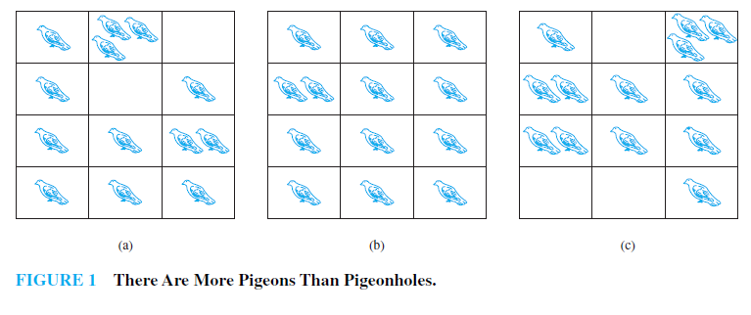
The Pigeonhole Principle
Suppose that a flock of 20 pigeons flies into a set of 19 pigeonholes to roost. Because there are 20 pigeons but only 19 pigeonholes, a least one of these 19 pigeonholes must have at least two pigeons in it. To see why this is true, note that if each pigeonhole had at most one pigeon in it, at most 19 pigeons, one per hole, could be accommodated.
This illustrates a general principle called the pigeonhole principle, which states that if there are more pigeons than pigeonholes, then there must be at least one pigeonhole with at least two pigeons in it . Of course, this principle applies to other objects besides pigeons and pigeonholes.

Slide 20
Continue
If k is a positive integer and k + 1 or more objects are placed into k boxes, then there is at least one box containing two or more of the objects.
Example
Among any group of 367 people, there must be at least two with the same birthday, because there are only 366 possible birthdays.
Example
In any group of 27 English words, there must be at least two that begin with the same letter, because there are 26 letters in the English alphabet.

Slide 21
Example
How many students must be in a class to guarantee that at least two students receive the same score on the final exam, if the exam is graded on a scale from 0 to 100 points?
Solution
There are 101 possible scores on the final. The pigeonhole principle shows that among many 102 students there must be at least 2 students with the same score.

Slide 22
Permutation
A permutation of a set of distinct objects is an ordered arrangement of these objects. We also are interested in ordered arrangements of some of the elements of a set. An ordered arrangement of r elements of a set is called an r-permutation.
Example
Let S = {1, 2, 3}.The ordered arrangement 3, 1, 2 is a 3-permutation of S. The ordered arrangement 3, 2 is a 2-permutation of S.
Points to know
The number of r-permutations of a set with n elements is denoted by P(n, r). We can find P(n, r) using the product rule.

Slide 23
Example
Let S = {a, b, c}. The 2-permutations of S are the ordered arrangements a, b; a, c; b, a; b, c; c, a; and c, b. Consequently, there are six 2-permutations of this set with three elements. There are always six 2-permutations of a set with three elements. There are three ways to choose the first element of the arrangement. There are two ways to choose the second element of the arrangement, because it must be different from the first element. Hence, by the product rule, we see that P(3, 2) = 3 · 2 = 6.

Slide 24
Example
In how many ways can we select three students from a group of five students to stand in line for a picture? In how many ways can we arrange all five of these students in a line for a picture?
Solution
First, note that the order in which we select the students matters. There are five ways to select the first student to stand at the start of the line. Once this student has been selected, there are four ways to select the second student in the line. After the first and second students have been selected, there are three ways to select the third student in the line. By the product rule, there are 5 · 4 · 3 = 60 ways to select three students from a group of five students to stand in line for a picture.
To arrange all five students in a line for a picture, we select the first student in five ways, the second in four ways, the third in three ways, the fourth in two ways, and the fifth in one way. Consequently, there are 5 · 4 · 3 · 2 · 1 = 120 ways to arrange all five students in a line for a picture.

Slide 25
Theorem
If n is a positive integer and r is an integer with 1 ≤ r ≤ n, then there are
P(n, r) = n(n − 1)(n − 2) · · · (n − r + 1)
r-permutations of a set with n distinct elements.
Proof
We will use the product rule to prove that this formula is correct. The first element of the permutation can be chosen in n ways because there are n elements in the set. There are n − 1 ways to choose the second element of the permutation, because there are n − 1 elements left in the set after using the element picked for the first position. Similarly, there are n − 2 ways to choose the third element, and so on, until there are exactly n − (r − 1) = n − r + 1 ways to choose the rth element. Consequently, by the product rule, there are n(n − 1)(n − 2) · · · (n − r + 1) r-permutations of the set.

Slide 26
Proof-Continue
Note that P(n, 0) = 1 whenever n is a nonnegative integer because there is exactly one way to order zero elements. That is, there is exactly one list with no elements in it, namely the empty list.

Slide 27
Example
How many ways are there to select a first-prize winner, a second-prize winner, and a third-prize winner from 100 different people who have entered a contest?
Solution
Because it matters which person wins which prize, the number of ways to pick the three prize winners is the number of ordered selections of three elements from a set of 100 elements, that is, the number of 3-permutations of a set of 100 elements. Consequently, the answer is
P(100, 3) = 100 · 99 · 98 = 970,200.

Slide 28
Example
Suppose that there are eight runners in a race. The winner receives a gold medal, the second place finisher receives a silver medal, and the third-place finisher receives a bronze medal. How many different ways are there to award these medals, if all possible outcomes of the race can occur and there are no ties?
Solution
The number of different ways to award the medals is the number of 3-permutations of a set with eight elements. Hence, there are P(8, 3) = 8 · 7 · 6 = 336 possible ways to award the medals.

Slide 29
Example
Suppose that a saleswoman has to visit eight different cities. She must begin her trip in a specified city, but she can visit the other seven cities in any order she wishes. How many possible orders can the saleswoman use when visiting these cities?
Solution
The number of possible paths between the cities is the number of permutations of seven elements, because the first city is determined, but the remaining seven can be ordered arbitrarily. Consequently, there are 7! = 7 · 6 · 5 · 4 · 3 · 2 · 1 = 5040 ways for the saleswoman to choose her tour.

Slide 30
Example
How many permutations of the letters ABCDEFGH contain the string ABC ?
Solution
Because the letters ABC must occur as a block, we can find the answer by finding the number of permutations of six objects, namely, the block ABC and the individual letters D, E, F, G, and H. Because these six objects can occur in any order, there are 6! = 720 permutations of the letters ABCDEFGH in which ABC occurs as a block.

Slide 31
Combination
We now turn our attention to counting unordered selections of objects.
An r-combination of elements of a set is an unordered selection of r elements from the set. Thus, an r-combination is simply a subset of the set with r elements.
The number of r-combinations of a set with n distinct elements is denoted by C(n, r). Note that C(n, r) is also denoted by n r and is called a binomial coefficient.

Slide 32
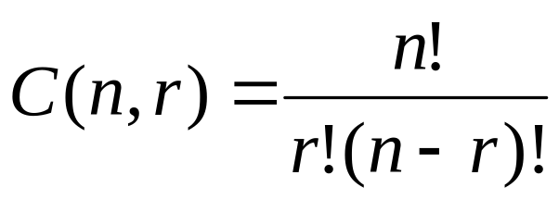
Example
Let S be the set {1, 2, 3, 4}. Then {1, 3, 4} is a 3-combination from S. (Note that {4, 1, 3} is the same 3-combination as {1, 3, 4}, because the order in which the elements of a set are listed does not matter.)
Example
We see that C(4, 2) = 6, because the 2-combinations of {a, b, c, d} are the six subsets {a, b}, {a, c}, {a, d}, {b, c}, {b, d}, and {c, d}.
Theorem
The number of r-combinations of a set with n elements, where n is a nonnegative integer and r is an integer with 0 ≤ r ≤ n, equals

Slide 33
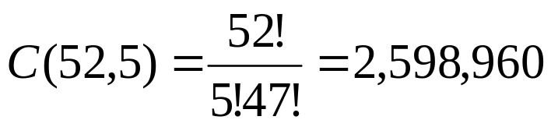
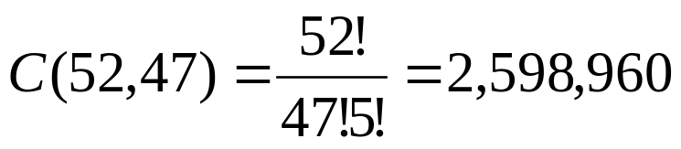
Example
How many poker hands of five cards can be dealt from a standard deck of 52 cards? Also, how many ways are there to select 47 cards from a standard deck of 52 cards?
Solution
Because the order in which the five cards are dealt from a deck of 52 cards does not matter, there are
different hands of five cards that can be dealt.
Note that there are
different ways to select 47 cards from a standard deck of 52 cards.

Slide 34
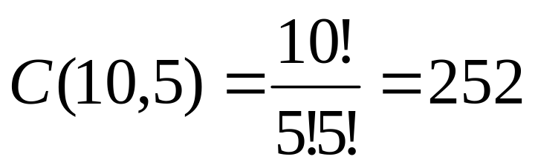
Example
How many ways are there to select five players from a 10-member tennis team to make a trip to a match at another school?
Solution
The answer is given by the number of 5-combinations of a set with 10 elements. The number of such combinations is

Slide 35

Example
A group of 30 people have been trained as astronauts to go on the first mission to Mars. How many ways are there to select a crew of six people to go on this mission ?
Solution
The number of ways to select a crew of six from the pool of 30 people is the number of 6-combinations of a set with 30 elements, because the order in which these people are chosen does not matter.
The number of such combinations is

Slide 36
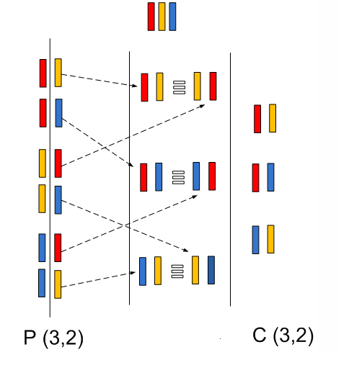
Difference between permutation and combination

Slide 37
End

